Slide 1
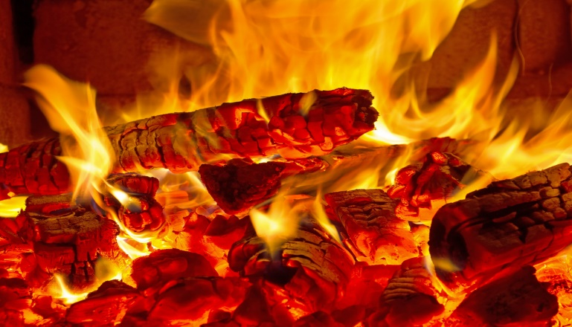
Introduction to Biochar
Jeff Sorkin, USDA - Forest Service
WESTAR, November 2024
Slide Credits: Heather Nobert, Nebraska Forest Service; USBI and Cornell Cooperative Extension of Suffolk County Biochar Webinar Series; Brian Brashaw, United States Forest Service

Slide 2
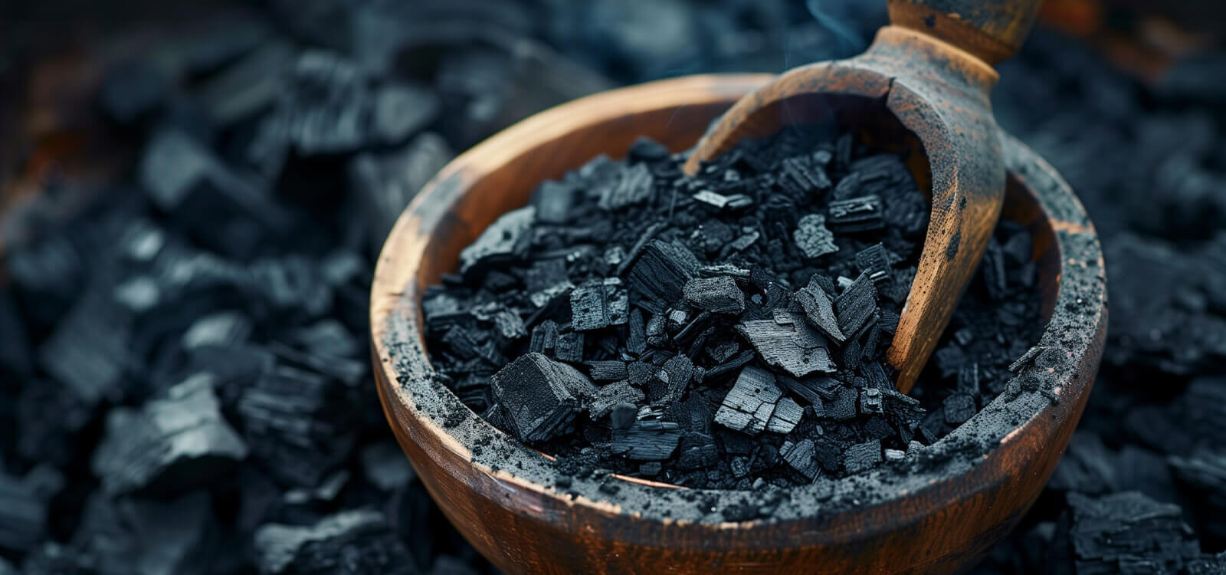
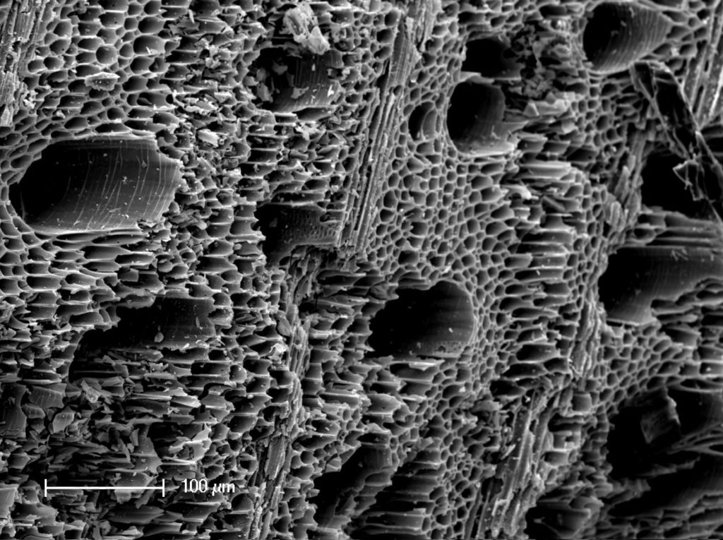
What is Biochar?
Biochar is a solid, carbon-rich material obtained from the carbonization of biomass. It is similar to charcoal in production and composition; its main distinguishing feature is that it is resistant to decomposition and mainly used as a soil amendment while charcoal is mainly used as fuel.

Slide 3
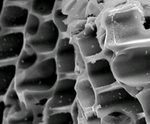
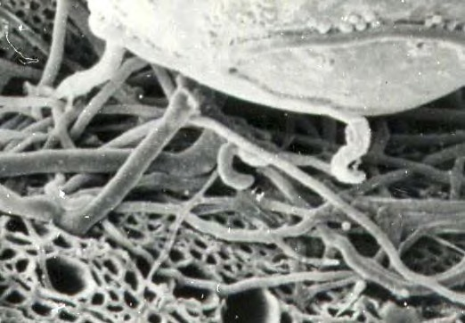
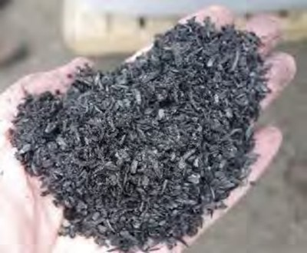

What is Biochar?
Biochar is processed so that physical, chemical, and biological properties improve soil health and hydrology
Biochars are fine-grained, highly porous charcoals that help soils retain nutrients and water.
Collins 2009
Mycorrhizal fungal hyphae growing from spore base invade large charcoal pores Ogawa 2004
Slide credit:
Cornell Cooperative Extension of Suffolk County Biochar Webinar Series
4

Slide 4
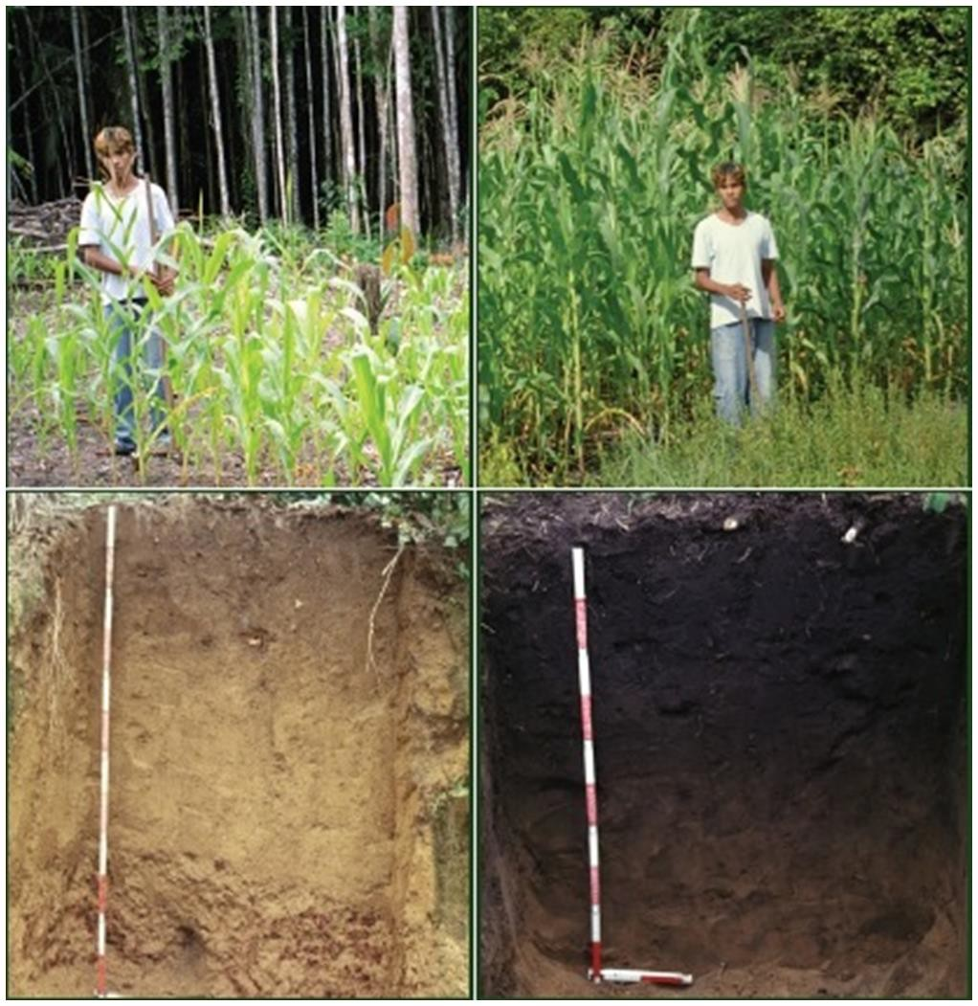
Biochar history
 Pre-Colombian anthropogenic soils
 2,500 year history
 Composed of:
 Cooking and household
wastes
 Manures
 Bones
 Darker and richer than
typical Amazonian soils

Slide 5
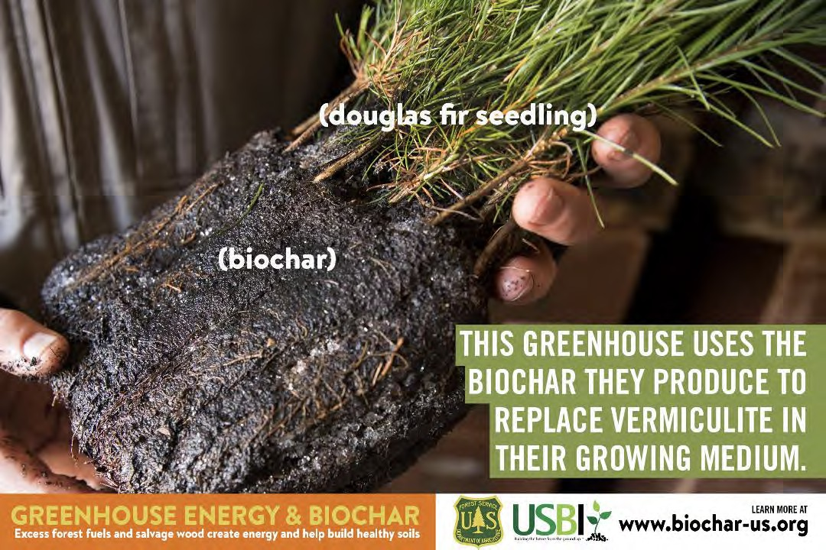
7
Slide credit:
Cornell Cooperative Extension of Suffolk County Biochar Webinar Series

Slide 6
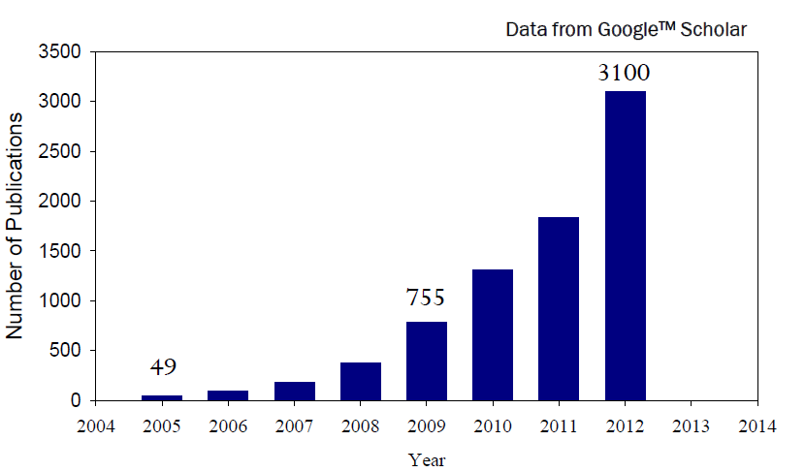
Biochar today
 “Biochar” first used in 1988
 Number of scientific publications steadily increasing
 General term for any number of black carbon products

Slide 7

Black carbon and biochar
Black carbon is a range of solids resulting from thermal conversion of any carbon containing materials
Biochar is NOT a new discovery or material
Oyxgen to carbon (O:C) molar ratio
Biochar
0.25
0
0.5
0.75
1.0
Soot
Char
Graphite
Charcoal
Biomass

Slide 8
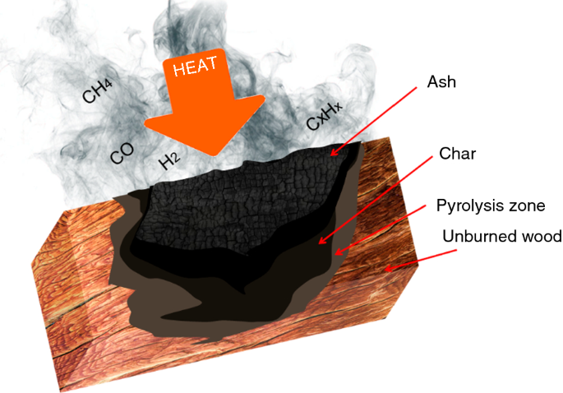
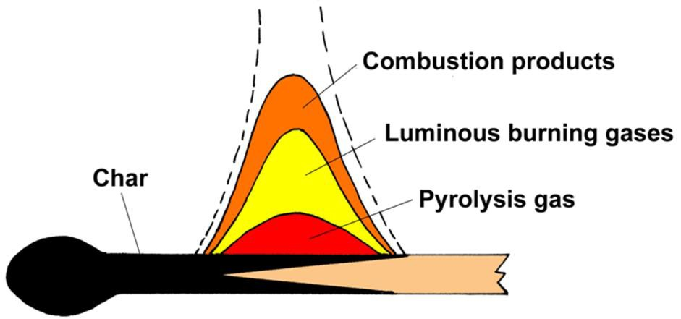
How is it produced?
 Pyrolysis or gasification
 Changing the chemical structure of the biomass
 “burn off” volatiles, moisture, etc. left with pure carbon
 Limited oxygen environment
 Very high heat >400ºC

Slide 9
What can biochar do?
 Fight climate change
 Enhance soil fertility
 Protect water quality
 Reduce forestry and agricultural wastes

Slide 10
Fight climate change
 Carbon negative
 Biomass is carbon neutral
 Biochar acts as a carbon sink
 Persists in soils for decades – millennia
 Reduces in-woods and on-farm burning of forestry and
agricultural wastes
 May reduce nitrous oxide (N₂0) and methane (CH₄) emissions in agricultural soils

Slide 11





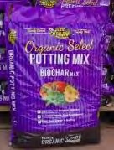
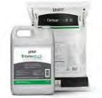
Biochar Uses
Agriculture, Retail Garden, Landscape, Turf, Horticulture
Biochar, Compost
Composted biochar (5%-20% biochar)
Biochar-Based Compound Fertilizers (15%-25% biochar)
Biotic Soil Amendments (biochar + organics+ minerals and biologicals) Granulated and liquid products for seeding
Micro/nano carbons
Environment, Remediation, Erosion Control
Green urban infrastructure, remediation, odor control Mine reclamation, Oilfield remediation, Filtration
Stormwater filtration, water treatment - functionalized chars
Water quality – Bioretention, filtration, infiltration
Forestry
Forest Fuels and Reforestation, Range Improvement Growing media for nursery and out planting Revegetation, Reclamation of mines, degraded land
Non-soil carbon products
Animal feed, building products, carbon nanotubes
Cornell Cooperative Extension of Suffolk County Biochar Webinar Series
8
Slide credit:
Cornell Cooperative Extension of Suffolk County Biochar Webinar Series

Slide 12
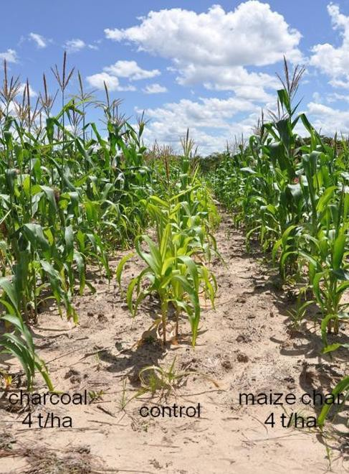
Enhance soil fertility
 Attracts and retains nutrients
 Increases cation exchange
capacity (CEC)
 Stimulates beneficial soil microbiota
 Biochar pores provide a suitable habitat for microorganisms
 Soil microbiota are necessary for plant growth and development
 Addition of trace nutrients (Mo, B, S, Cu)
 Improves aerations/bulk density
Changes
 Acts as a liming agent
 Improves water holding capacity of soils

Slide 13
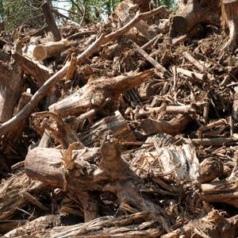
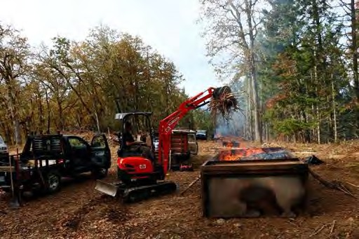

Waste reduction
 Creates a value- added product from forestry and agricultural wastes
 Diverts community wood waste from landfill or burning
 Can be used in-situ or sold for profit

Slide 14
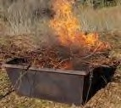
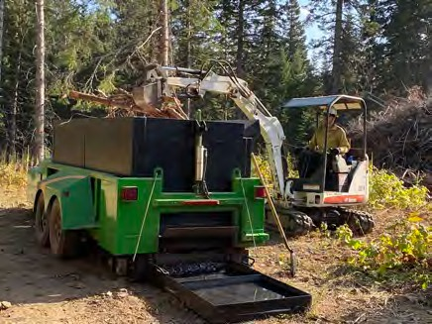
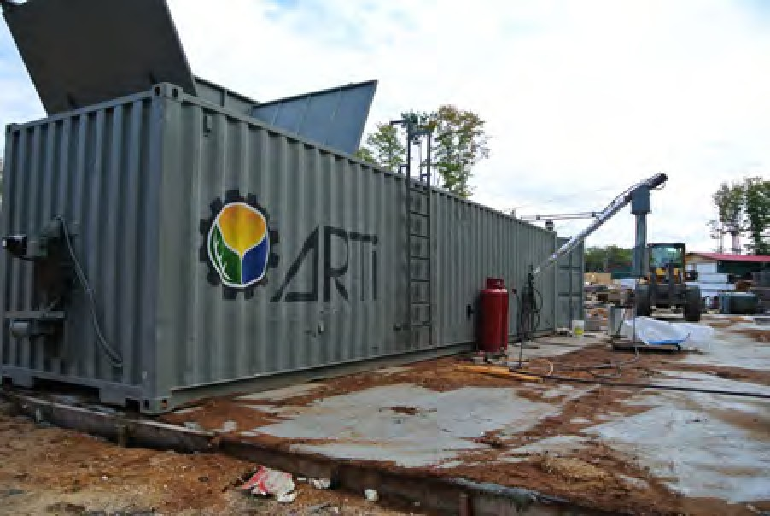
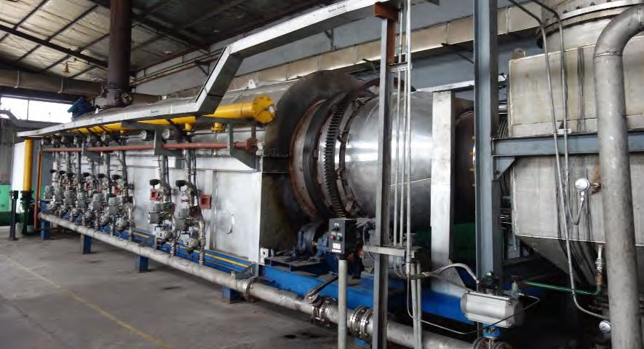
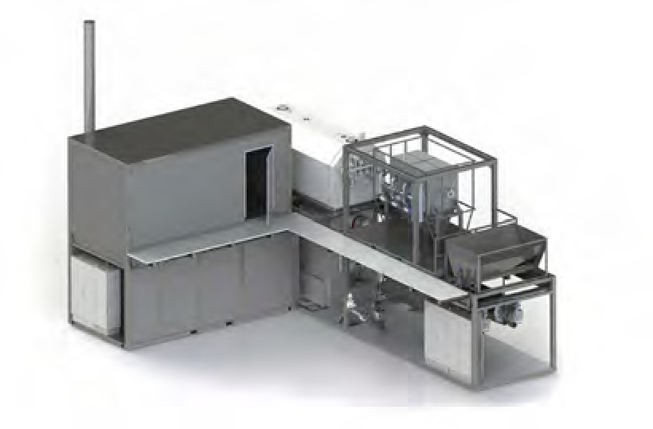
Biochar Technologies
Onsite
Offsite
  Distributed
  Centralized
Cornell Cooperative Extension of Suffolk County
Biochar Webinar Series

Slide 15
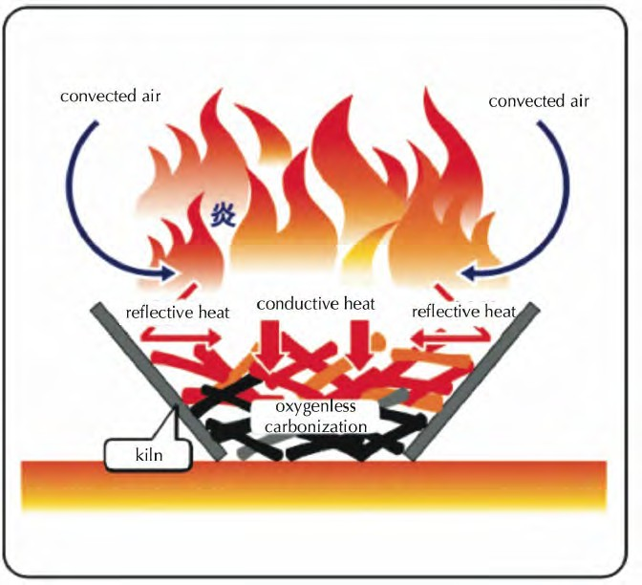
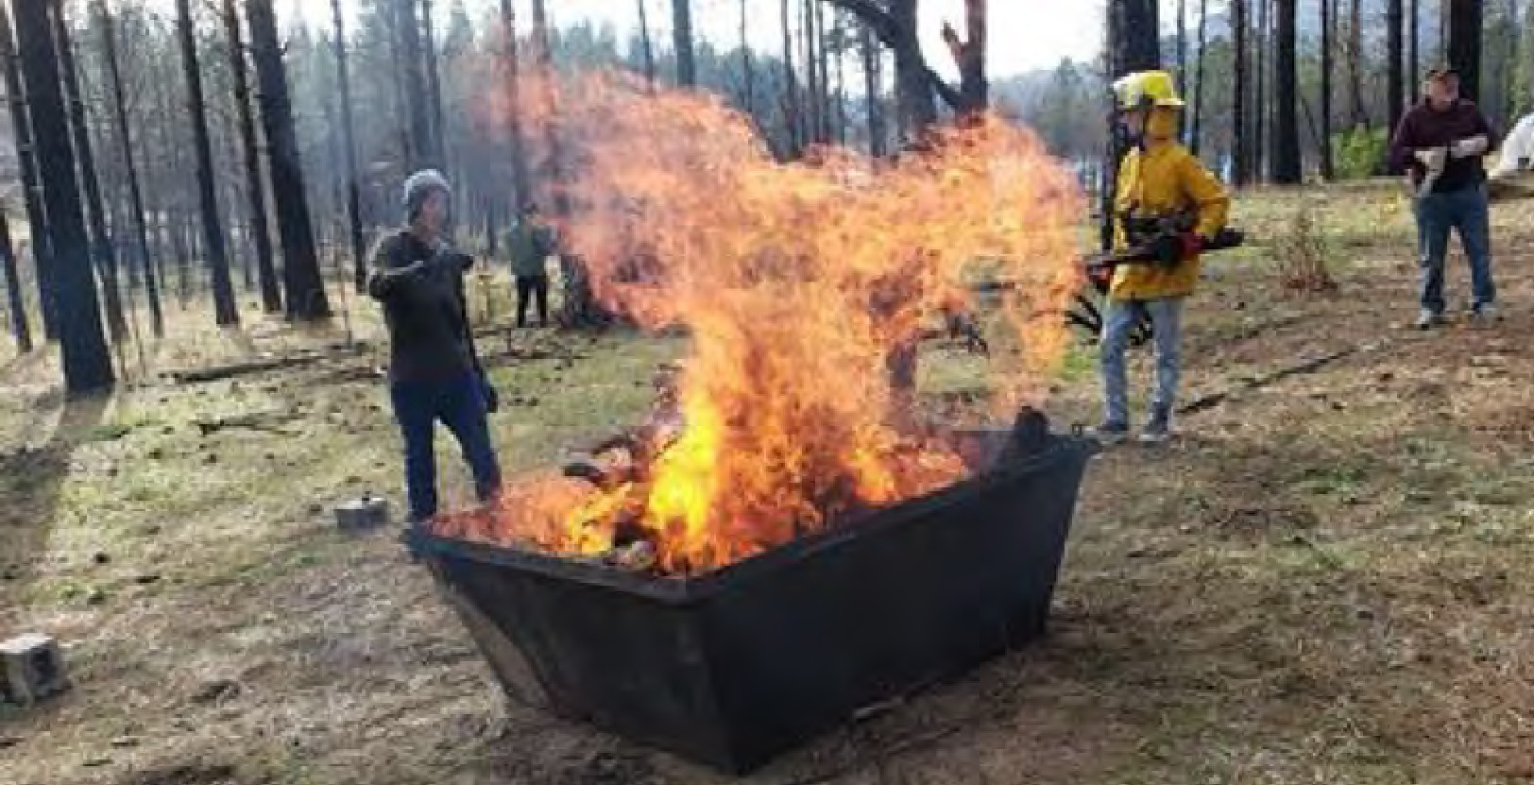
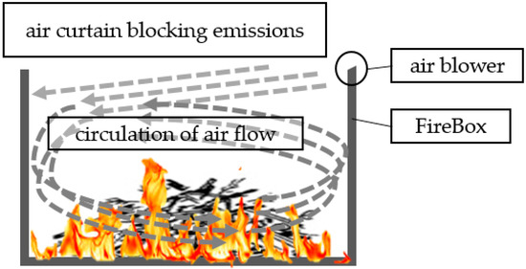
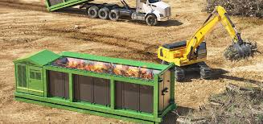
Portable, Small Scale
Flame cap method in a “box burner”

Slide 16


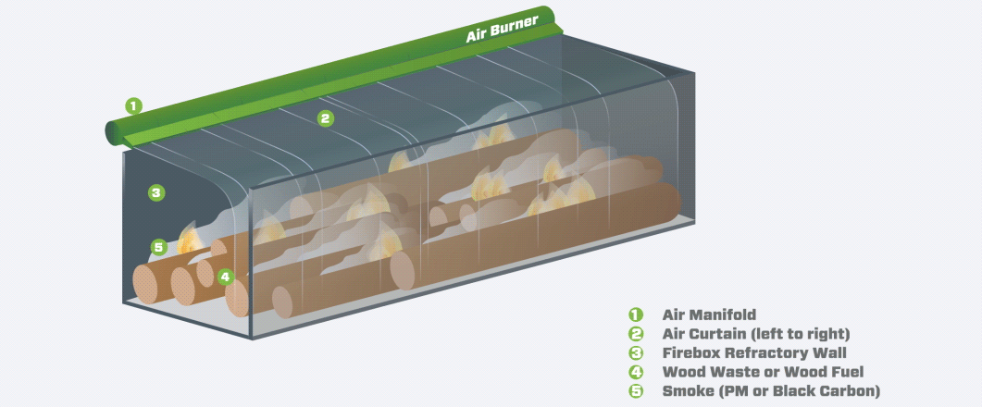



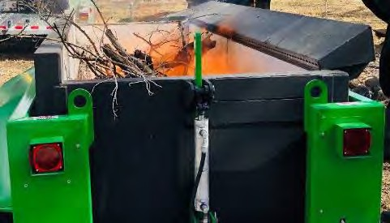
ACIs
Curtain of air burns gases. Biochar is withdrawn continuously through a grate.
Prototype – 1 ton (10-20CY) per hour IN
Airburners.com
1 tons (8-10 CY)/day OUT
airburners.com
CharBoss by Air Burners Inc.- USFS Cooperative Research and Development Agreement
7 CY Chamber
4’ x 4’ x 12’
41
Cornell Cooperative Extension of Suffolk County Biochar Webinar Series

Slide 17
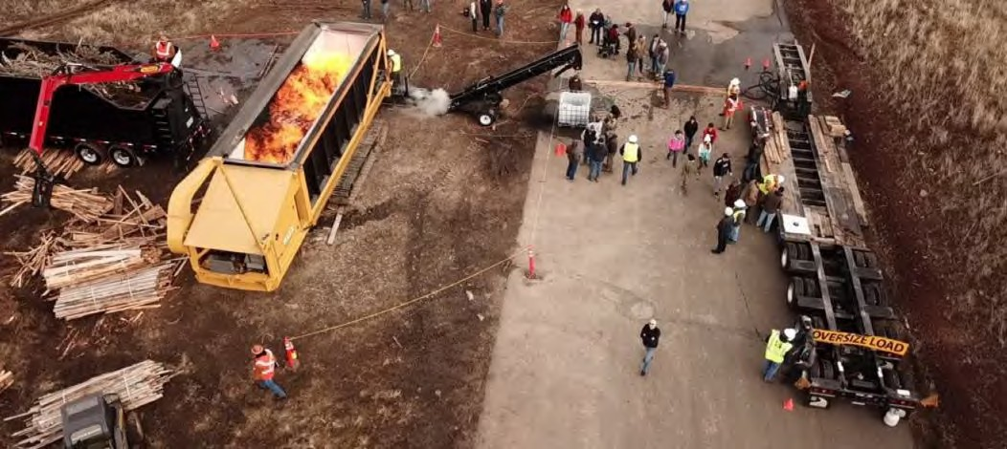
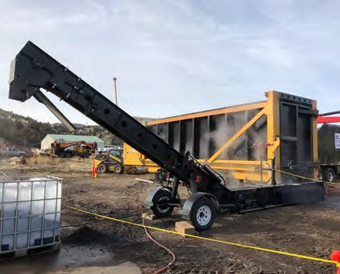
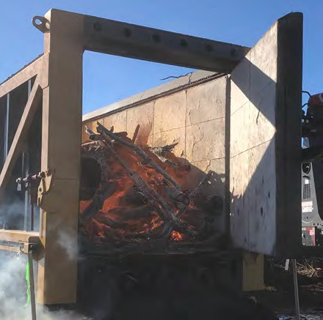
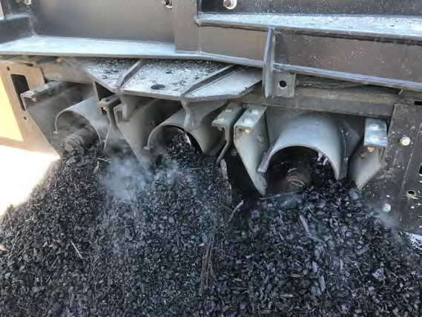
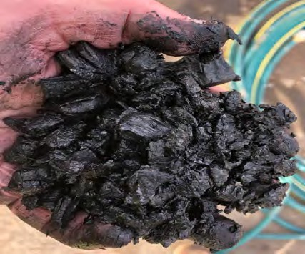
Onsite/Offsite: Mobile Carbonizers
Cornell Cooperative Extension of Suffolk County Biochar Webinar Series
www.tigercat.com
42

Slide 18
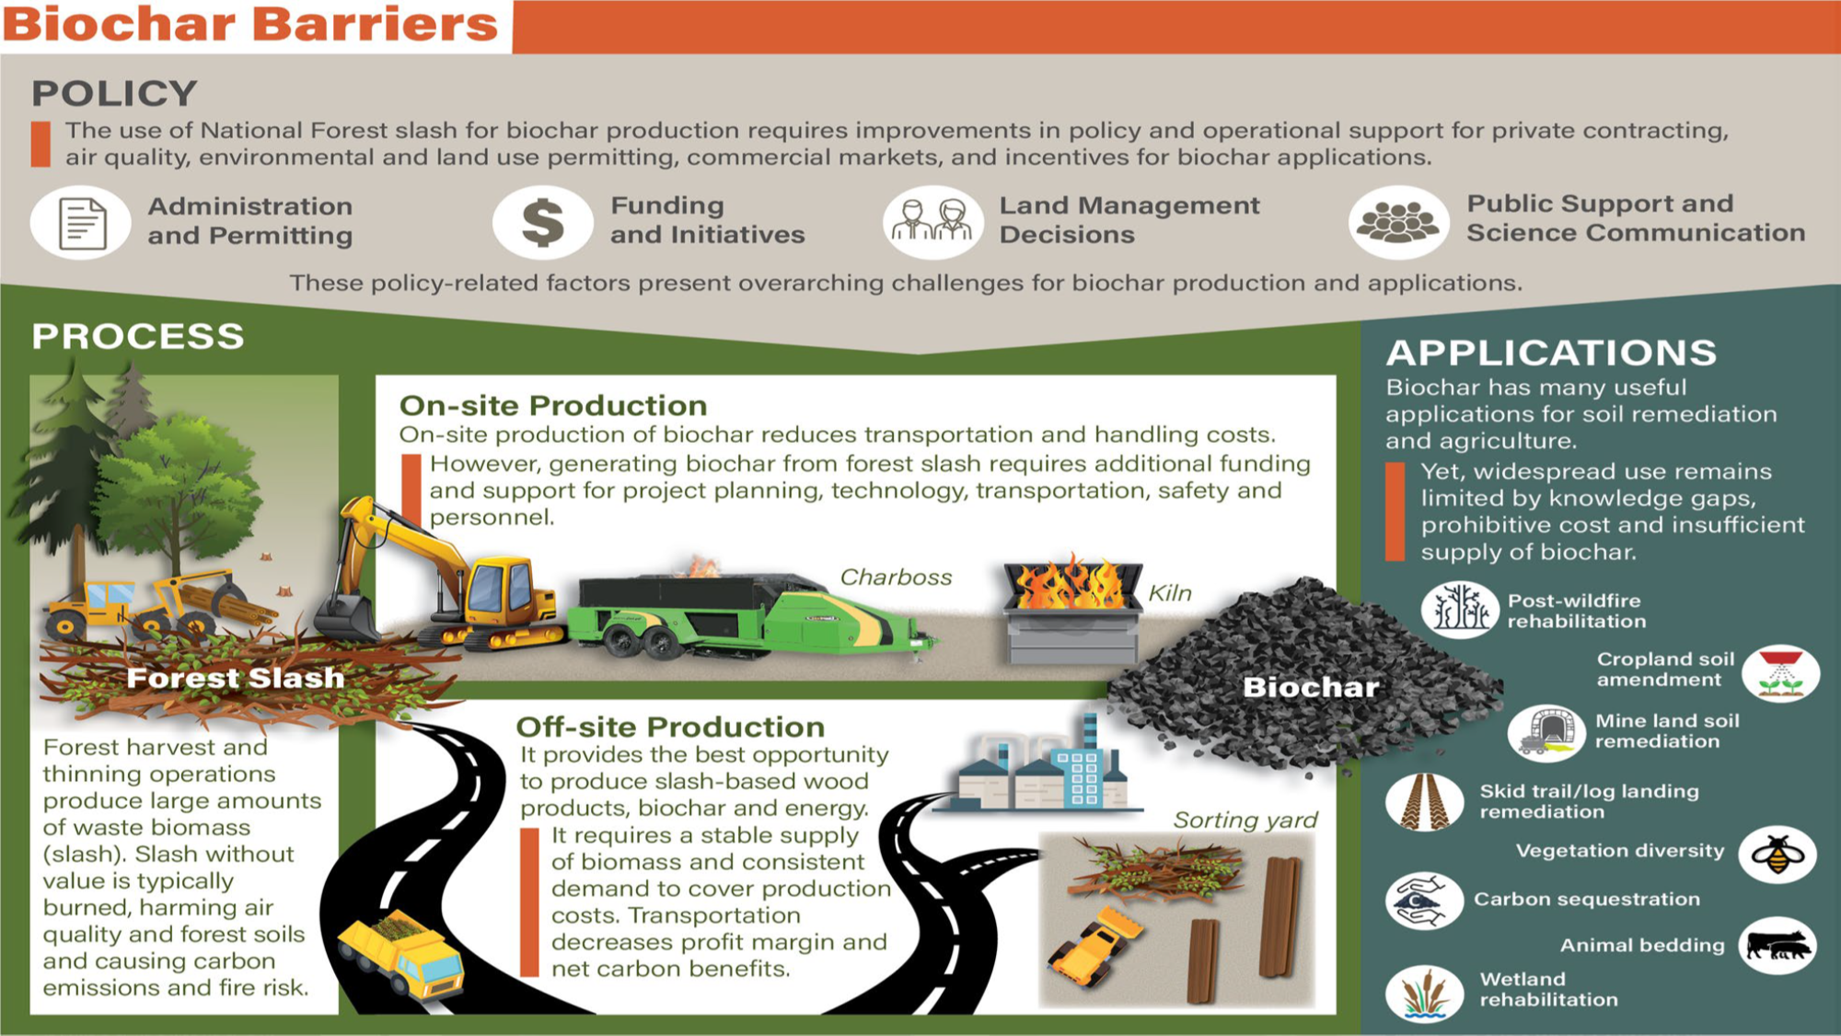

Slide 19
ACIs and Biochar
Burning in ACIs with or without biochar production will never be a large part of how we get to healthy, resilient forests because:
Fire dependent ecosystems must burn
Fire adapted ecosystems need fire for optimum health
We know that thinning alone does not restore forests or change fire risk much, it is thinning followed by Rx fire that makes a difference.
There is too much material and most of it is hard to get to or far from roads.
Throughput on the machines is relatively low
… and of course, $
Therefore, it is a tool FS will use in areas where it is practical and ecologically beneficial, and where open burning is otherwise problematic (air quality, adjacency).

Slide 20
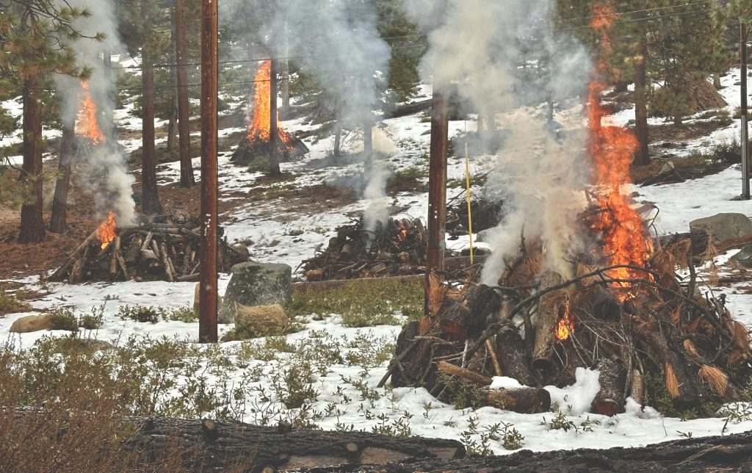
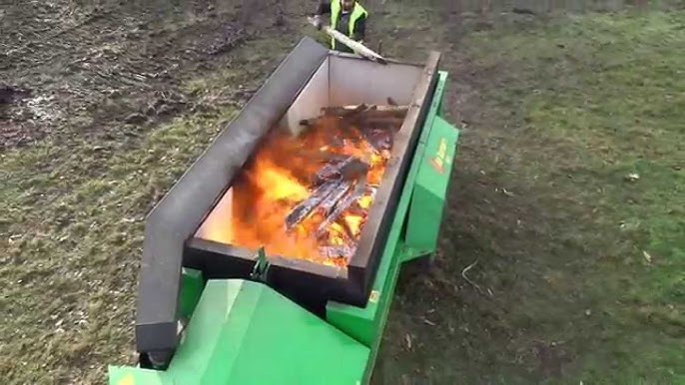
Air Pollution Reduction
Pile burning or wildfire
Video1:56 to end
Video 0:00 to 1:02

Slide 23
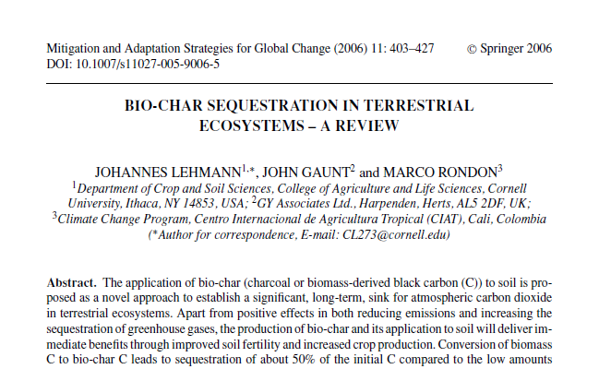
GHGs
“Conversion of biomass C[arbon] to bio-char C[arbon] leads to sequestration of about 50% of the initial C[arbon] compared to the low amounts retained after burning (3%) and biological decomposition (<10–20% after 5–10 years), therefore yielding more stable soil C[arbon] than burning or direct land application of biomass…Biochar carbon is extremely slow to decompose and thus will reside in soil for hundreds to thousands of years, providing both climate change mitigation and soil carbon benefits”

Slide 24
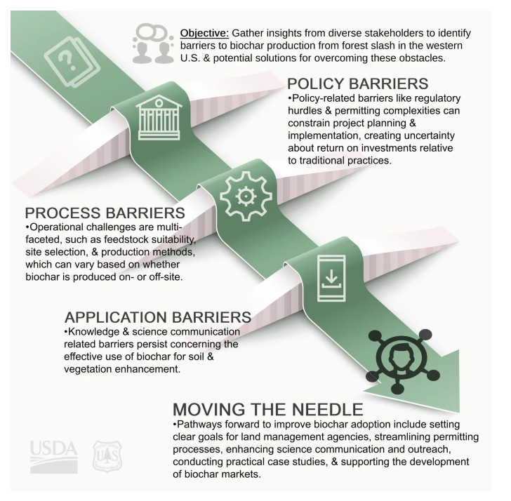
Policy challenges
Inconsistent permitting across states
Costs of permits, time required for permitting
Solid waste determinations

Slide 25
Permitting for ACIs
US EPA
On November 4, 2024, the U.S. Environmental Protection Agency issued technical corrections to a final rule that removed title V permit requirements for air curtain incinerators that burn only wood waste, clean lumber, yard waste, or a mixture of these three types of waste. EPA issued the final action to remove the title V permitting requirements for ACIs on April 17, 2024. Today’s action corrects inadvertent errors in the regulatory text to align it with the final rule preamble. Air curtain incinerators that only burn these types of waste will be required to continue to comply with the opacity requirements in the Other Solid Waste Incinerator (OSWI) rule.
Learn more: https://www.epa.gov/stationary-sources-air-pollution/other-solid-waste-incinerators-oswi-new-source-performance

Slide 26
South Dakota
There are no specific biochar regulations.
If there will be over 25 tons of criteria pollutants or over 10 tons of single hazardous air pollutants, then it would require a permit.
For both mobile and permanent biochar units, an application would need to be submitted to the environmental departments you think you might need a permit for.
Then, an engineer will review it, calculate emissions, and either write up a permit or let you know if you don't need one.
.

Slide 27
Utah
Nothing set up for permitting dealing specifically with biochar
Pyrolysis – they will look at heat input and the output that is being extracted
1. If it is a small project for a short duration of time,
a facility can remain there up to 180 days in a 365 day period. After that, would need formal application to proceed.
2. Optionally, just need de minimus application – helps assist the state with complaints so they can say they are aware of what is happening (De minimus level projects (up to 5 tons/year) – for combustion emissions and particulate emissions)
.

Slide 28
Arizona
As of today, there is no section for biochar/pyrolysis. However, a facility may be subject to other sections.
For example, if a facility uses an incinerator, it may be subject to A.A.C. R18-2-704. Or if a facility uses a boiler, it may be subject to A.A.C. R18-2-724.
The biggest factor pulling in requirements are federal regulations (code of federal regulations, CFR). For example, sub-part CCCC or sub-part EEEE that may require a facility to obtain an individual permit.
Then, the state would add its own regulations and embed them in the permit.
.

Slide 29
Colorado
All incinerators located in Colorado require a Construction Permit to operate (stationary and non-stationary). To begin the permit application process, begin by filling out an Air Pollutant Emissions Notice (APEN). There are different APEN forms for different types of equipment, but it would likely be the Crematory/Incinerator APEN: Form APCD-234. If the equipment is considered an Air Curtain Destructor (ACD), you would use the Air curtain destructor APEN: Form APCD-232.
There is a $242.00 fee per APEN, and the APEN is used as the permit application. There is additional billing for hours spent writing the construction permit (between 5-10 hours billed at $119/hr so $800-$1,400ish). Part of the application process is assessing whether or not a modeling analysis will be required. There is an exception for ACDs that burn only wood waste in remote locations and which will be used as an alternative to open burning. If this is not the case, the cost may be much higher if the modeling unit determines that a modeling analysis is required.
.

Slide 30
In addition to a construction permit, there are federal requirements that these units must comply with, most likely Sub-part CCCC (Standards of Performance for Commercial and Industrial Solid Waste Incineration Units) or Subpart EEEE (Standards of Performance for Other Solid Waste Incineration Units for Which Construction is Commenced After December 9, 2004, or for Which Modification or Reconstruction is Commenced on or After June 16, 2006). This depends on the amount of waste burned per day, type of waste/unit, and location of unit relative to the waste it processes. The EPA just removed the requirement for air curtain destructors that burn only clean wood waste to apply for and obtain a Title V permit. However, if the pyrolysis equipment is not considered an air curtain destructor, it may require a Title V Operating Permit.
Further, there may be additional solid waste permitting requirements for the solid waste treatment concept. In addition to obtaining approval from the local governing body, which is typically the county, waste-to-energy/pyrolysis operations are subject to Sections 1, 2, 4 and 11 of the Solid Waste Regulations.

Slide 31
The diesel engine may also require an APEN depending on the fuel usage/annual hourly usage (see APEN and Permitting Requirements for Engines link in folder). Diesel engines that are subject to New Source Performance Standard Subpart IIII must submit the APEN Addendum Form APCD-214 along with the engine APEN (Form APCD-233) (see links in folder).
Calculate emissions for diesel engines (see links in folder):
Determine if less than 600 HP or greater than 600 HP using manufacturer emission factors.
Guide to Permitting for Air Curtain Destructors (see link in folder). This covers the permitting requirements for ACDs in Colorado, but does not include federal requirements for ACDs. In this guidance, there are links to the engine APEN and calculators that can be used to determine whether an APEN is required for an engine. It also details operating requirements that may be included in an ACD permit.
Application for Beneficial Use Determination for the biochar application (see link in folder).
.

Slide 32
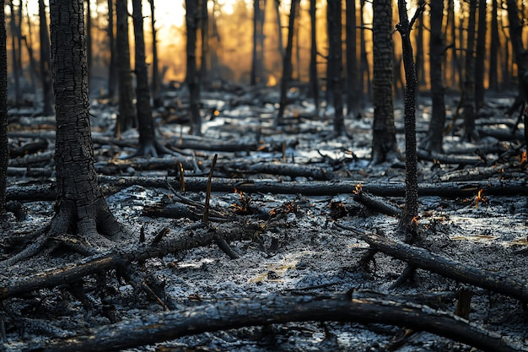

Slide 33
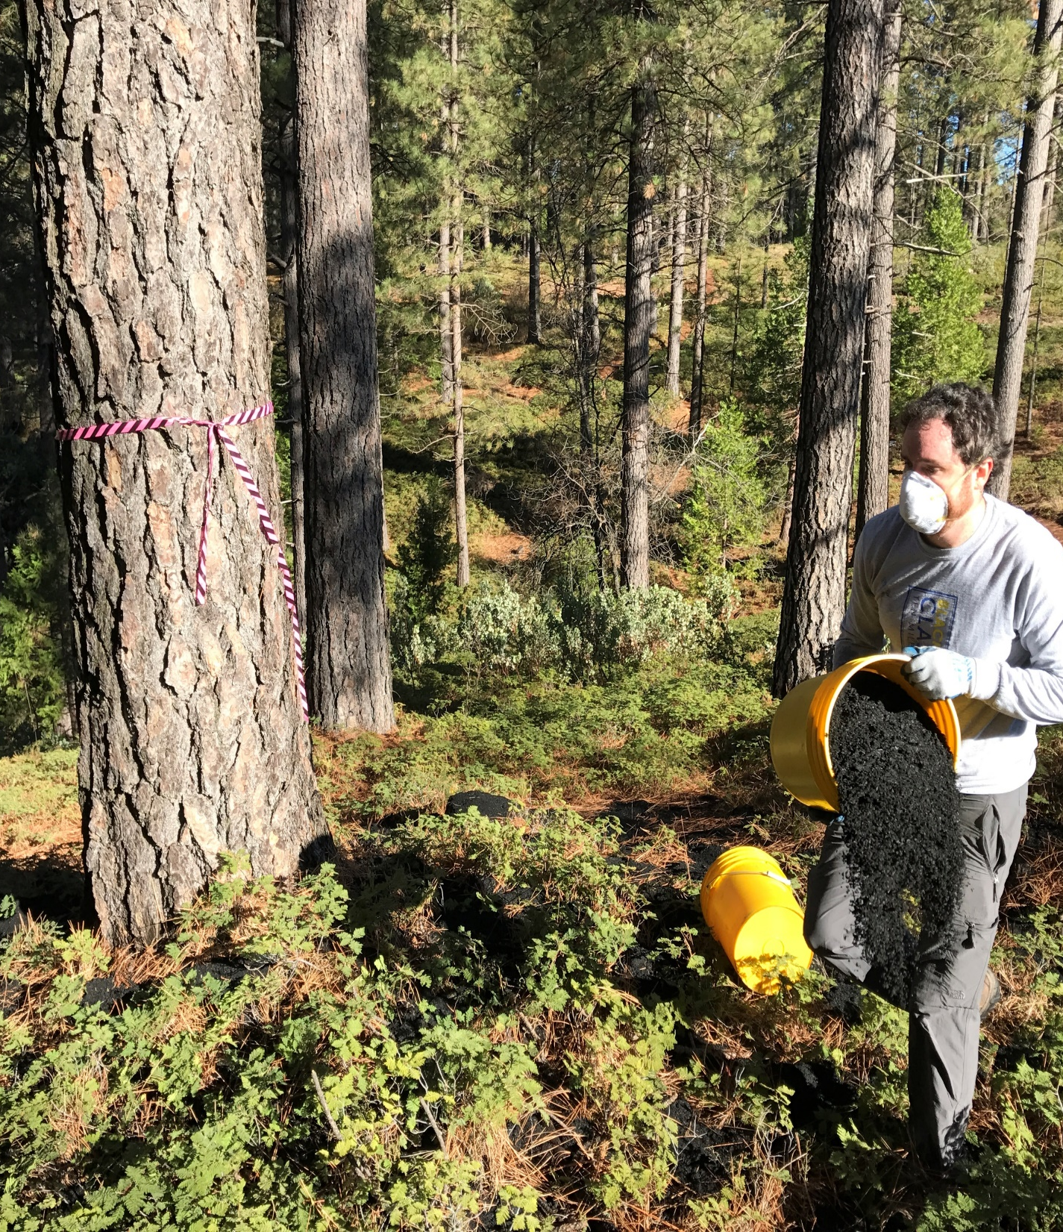
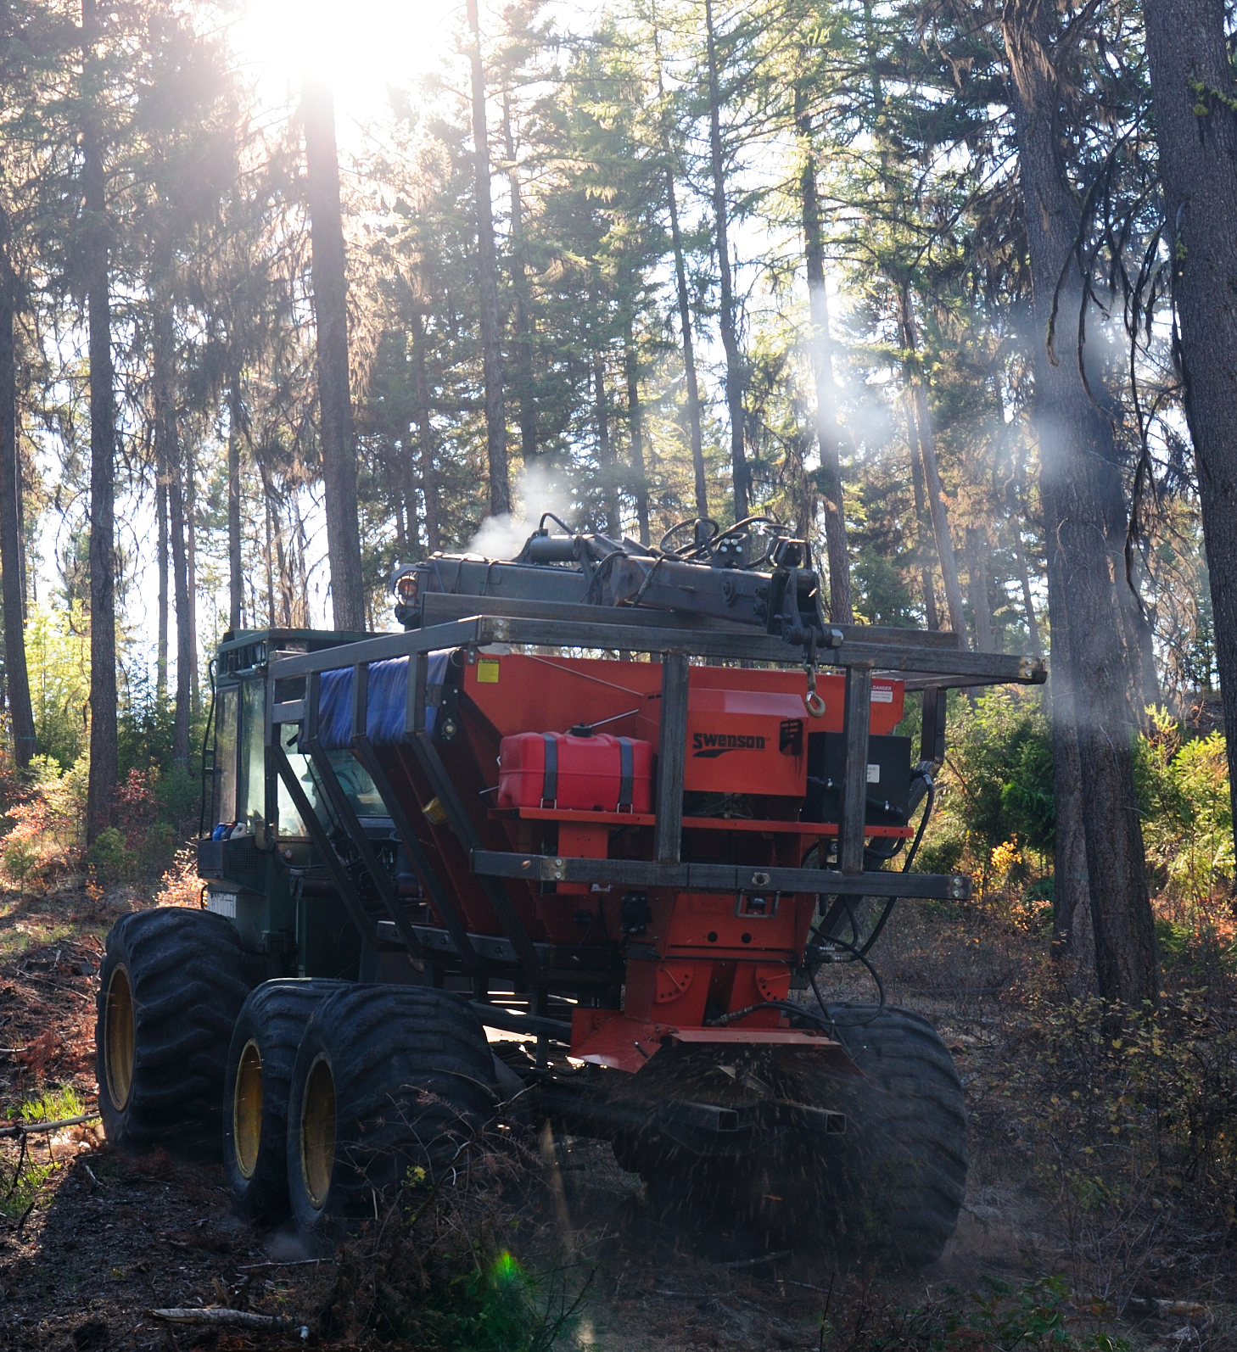

Slide 34
Where do we go from here?
How can biochar ACIs be successfully incorporated into the toolset for forest restoration projects?
What are the permitting needs for states to fulfill air quality management responsibilities?
How can permitting for ACIs specifically used for forest restoration be made simpler?

