Slide 1
Intermountain West Data Warehouse
IWDW Overview and Funding Update
WRAP Board Monthly Meeting
July 5, 2023 10:00 a.m. (Mountain)
(Remote meeting via webinar)

Slide 2
Overview: Introduction
What is the Intermountain West Data Warehouse?
Purpose:
Approach:
Audience:
Beneficiaries:
Resources:
Provide an easily-accessible source of data, tools, and documentation and thereby a significant cost savings
Streamline and refine the workflow for modeling data acquisition, organization, management, and evaluation
Modelers, analysts, researchers, planners, stakeholders
Land managers, federal agencies, states, tribes, and other consumers of modeled air quality data
Modeling platform inputs
Modeling platform outputs
Modeling platform software
Modeling platform documentation
Contextual data and metadata
Visualization and analysis tools
Notes:
Takeaway: The Data Warehouse was intended to save significant money over time for agencies that need to do modeling and manage modeling data.

Slide 3
Overview: Feature Highlights
Home page
Request Modeling Data
Model Performance Browser
Model-to-Observations Comparison Tool
Source Apportionment results
Emissions Review Tool
Emissions Inventory Browser
Monitoring Data and Tools
Wiki
Documents
News
Help
Notes:
These are the primary destinations on the Data Warehouse website, categorized according to their functional domain – modeling, emissions, monitoring, and the related documentation for each.

Slide 4
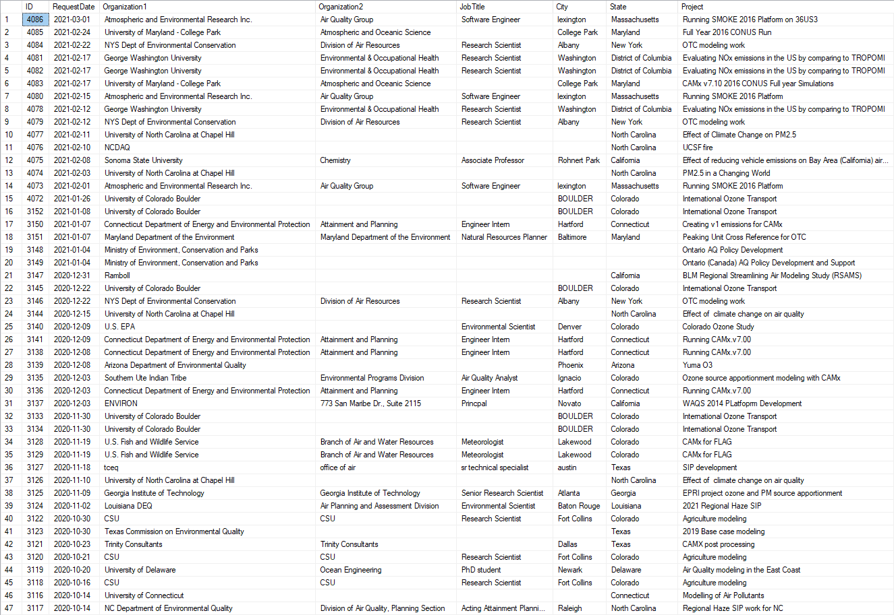
Data Request Tracking and Servicing
Notes:
This is a representative list of modeling platform data requests, summarized to show organizational composition and intended use.

Slide 5
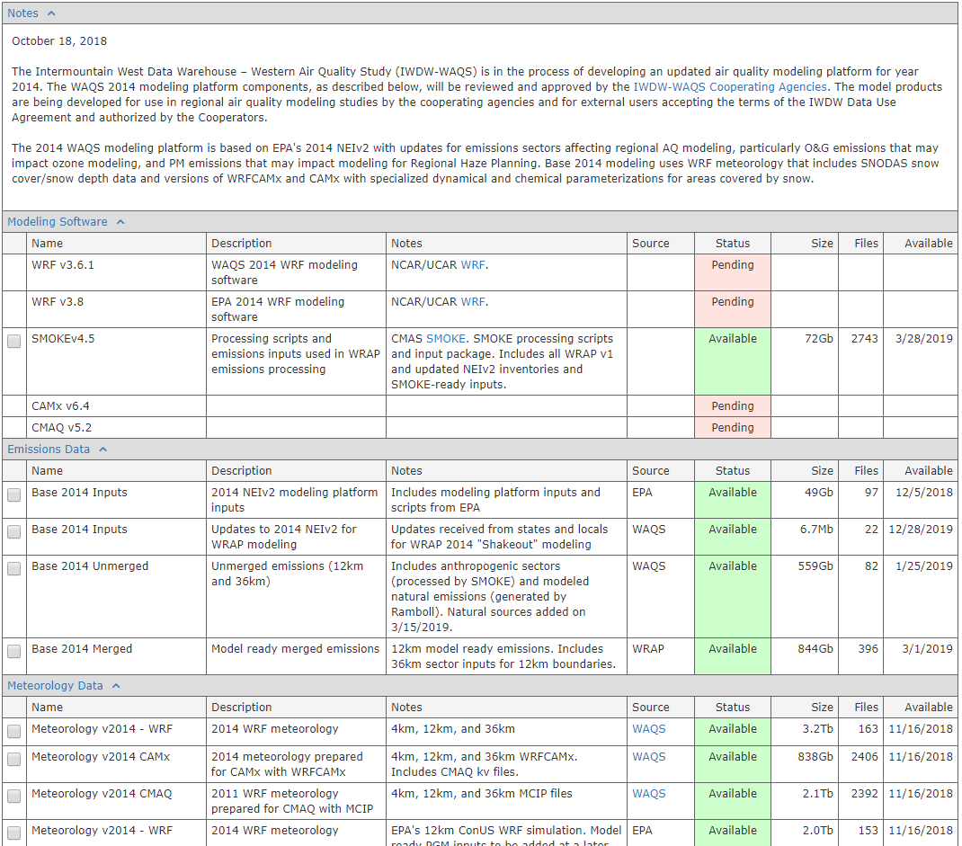
Modeling Platform Data Request Form
Purpose:
To facilitate the browsing, selection, and download of entire modeling platforms or individual modeling platform components, and to illustrate the expected roadmap for creating and distributing modeling platforms and individual platform scenarios. Platform components can be accessed and downloaded via SFTP, HTTP, and Globus, and extremely large-volume data requests can be delivered on physical hard drives via regular mail service.
Shows the status of the component
Request Data
Shows the estimated size of the component
Shows the total number of files
Shows the expected availability date
Notes:
How does one get modeling platform data from the Data Warehouse? By filling out the Data Request Form, which is the primary method for browsing, understanding, identifying, and downloading large sets of modeling data from the website.

Slide 6
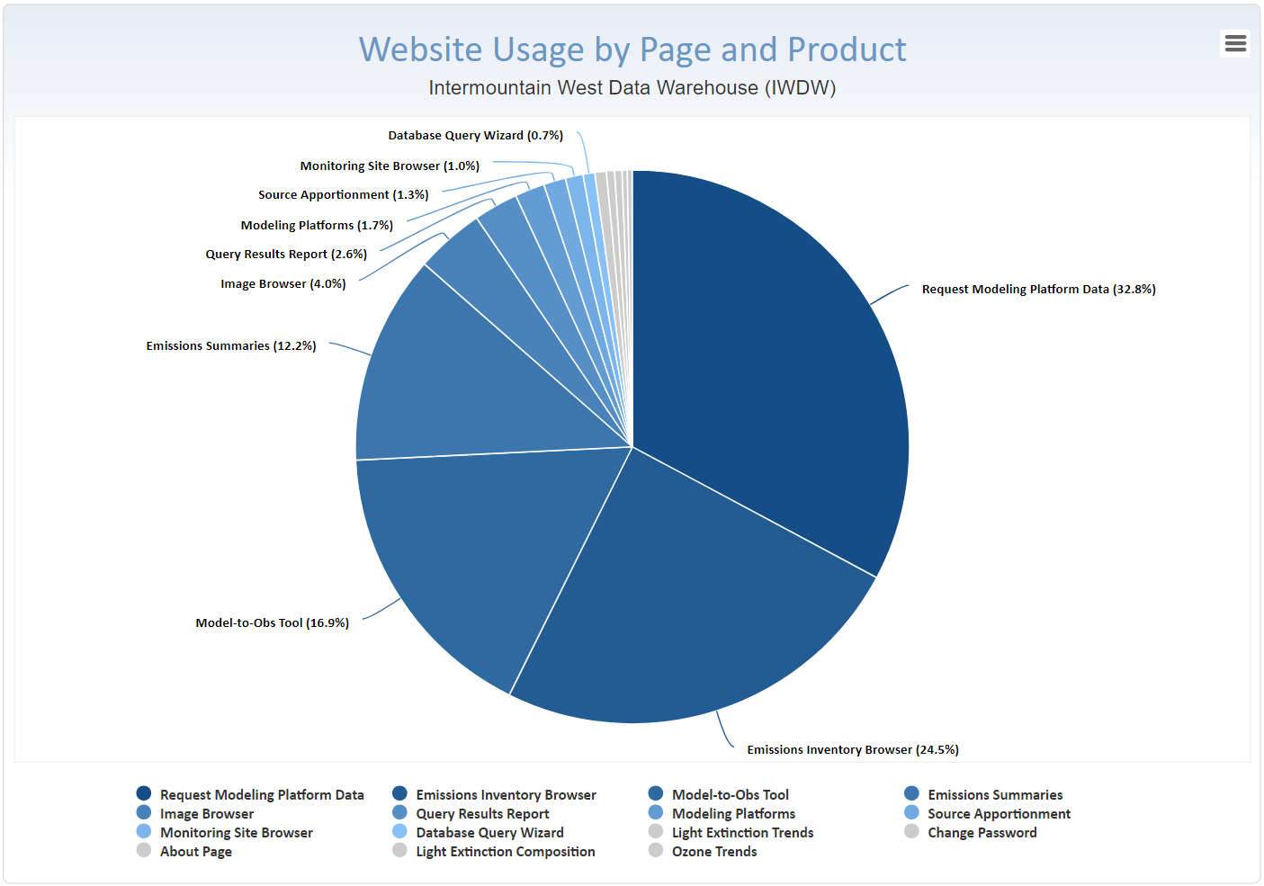
Overview: Usage Summary by Page and Product
Notes:
This is a breakdown of website usage by page and data product, showing the top 15 most used resources on the Data Warehouse website.

Slide 7
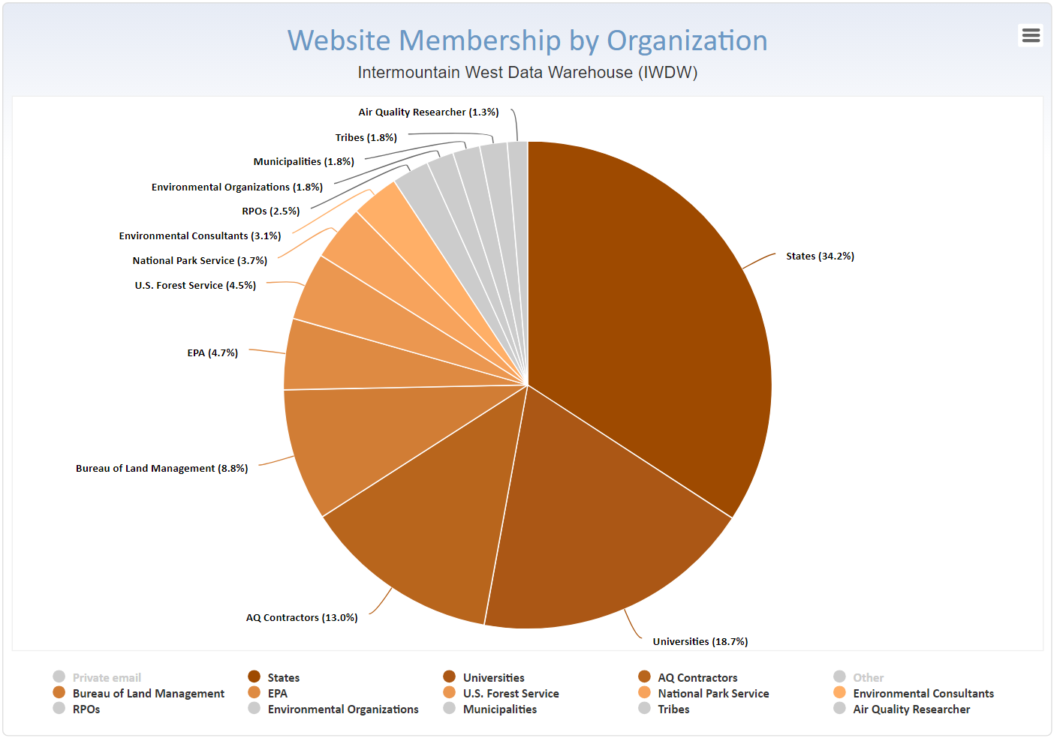
Overview: Membership Summary by Organization
Notes:
This is a breakdown of website membership by organization and agency, showing the top 15 organizations in terms of numbers of registered users.

Slide 8
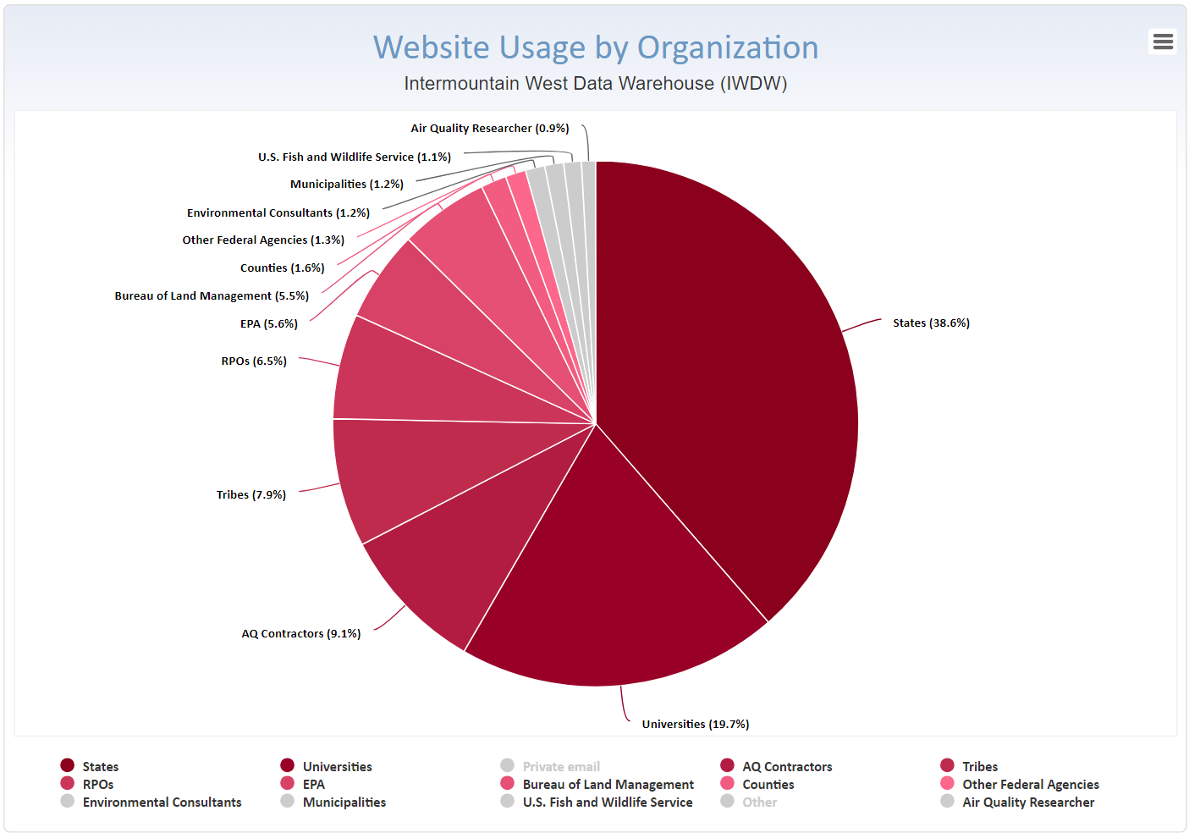
Overview: Usage Summary by Organization
Notes:
This is a breakdown of actual website usage by organization and agency, showing the top 15 organizations in terms of page and product usage. And if you toggle between this chart and the previous one, you’ll see that the membership and usage breakdown is very similar.

Slide 9
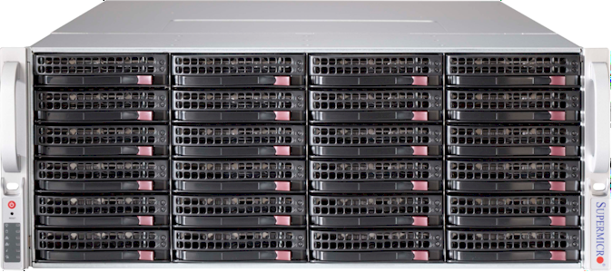
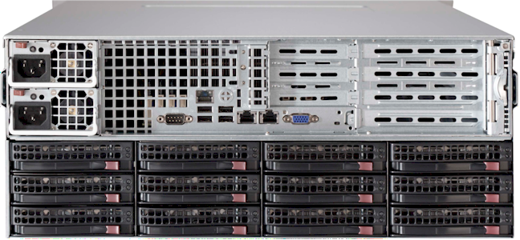
Overview: Modeling Platform File Servers
SuperMicro dual 6-core CPU file servers (current quantity: 3)
Front view
Back view
1 or 2 bays reserved for in-chassis data transfers
Redundant power supplies
Redundant network ports
Hardware features:
36 drive bays
Dual power supplies
Dual Ethernet ports
Rack-mounted
Storage Capacity:
VIKING: | 250 | Terabytes
VALKYR: | 400 | Terabytes
VISIGOTH: | 400 | Terabytes
 | 1.05 | Petabytes
Notes:
What is the Data Warehouse from an physical equipment perspective? Pictured here is one of the three large file servers used to store and manage the modeling platform data. Each of these 4U file servers has 36 hard drives in a RAID configuration. We have three of these so far, for a total of about 1 Petabyte of total storage, about 95% of which is in use between primary data storage and backup.

Slide 10
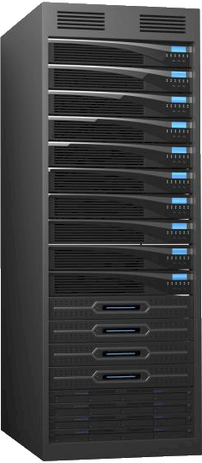
Overview: Web, Database, and Support Servers
Tower chassis production servers (current quantity: 8-10)
Web
Web
Database
Database
Backup
Backup
Backup
Web servers:
Production IWDW website
Local web services
FTP/SFTP data distribution
Support websites (GIS, images)
Database servers:
Monitoring, modeled, emissions
Import and staging databases
User membership and auth.
Spatial databases
Backup servers:
Automatic backups
Development and testing
Auxiliary data storage
Data copy and transfer
Notes:
We also have between 8 and 10 additional servers that serve in various crucial roles. There are a couple of web servers, a couple of database servers, and three backup and auxiliary servers. Some of these servers are shared with other projects.

Slide 11
Overview: IWDW Network Ecosystem
The Internet
Front Range Gigapop and the Internet2
Fiber optic networking to Atmos Hill
The CIRA subnetwork was phased out in 2017
CIRA subnetwork
100 Gigabit Ethernet within CIRA
IWDW Servers
Remote Desktop
Remote Desktop
Some servers have static public IPs
Some servers have static private IPs
Developer Workstation
Developer Workstation
Notes:
This is a view of how all this equipment sort of “hangs together” within the networking context of the larger CIRA/CSU network. One important thing to note is that as a university, CSU has an extremely big “pipe” for serving Internet traffic to and from the Data Warehouse servers.

Slide 12
CIRA Air Data Management System Ecosystem
Intermountain West Data Warehouse
(IWDW)
Partners: NPS, BLM, USFS, EPA, States
WRAP Technical Support System
(TSS)
Partners: NPS, USFS
Databases
Websites
Software
Hardware
Partially funded
Partially funded
OGEC Repository
Partners: EPA, States
NASA ROSES
Partners: NASA / NPS
CIRA Air Data Management System
VIEWS
Partners: EPA / States
NASA NAAPS
Partners: NASA / NPS
FLM Environmental
Database
(FED)
Partners: NPS, USFS
Southeastern
Modeling, Analysis, and Planning
(SEMAP)
Partners: EPA, Southeastern States
Partially funded
Notes:
This diagram is an introduction to the overall I.T. ecosystem that the Data Warehouse leverages, and into which it fits.
All these systems leverage the same foundational I.T. infrastructure, represented by the blue circle in the center.
We started referring to this foundational I.T. infrastructure as the CIRA Air Data Management System (ADMS)
All these systems have been easier, quicker, and therefore cheaper to build and maintain by virtue of leveraging the ADMS.
None of these systems are fully funded by themselves, but depend upon the full funding of at least 1 FTE in order to continue operating.

Slide 13
ADMS Ecosystem Timeline
2000: Original WRAP Database
2002: Visibility Information Exchange Website (VIEWS)
2004: National Ambient Air Toxics Archive (ATDA)
2005: WRAP Technical Support System version #1 (TSS)
2007: NASA ROSES – Satellite Data Enhancements
2008: NASA ROSES – Navy Aerosol Analysis & Pred. System
2009: U.S. Forest Service Water Data project
2009: Air Data Management System (ADMS)
2010: Cyberinfrastructure for AQ Management (CyAir)
2010: Southeastern Mgmt. and Planning (SEMAP) website
2011: Federal Land Manager Environmental Database (FED)
2011: Federal Leadership Forum (FLF)
2012: Three-State Data Warehouse (TSDW)
2017: Intermountain West Data Warehouse (IWDW)
2019: WRAP Technical Support System version #2 (TSSv2)
Data Warehouse
Notes:
Here is a timeline of how the ADMS evolved, and where the Data Warehouse fits within the evolution of this ecosystem.

Slide 14
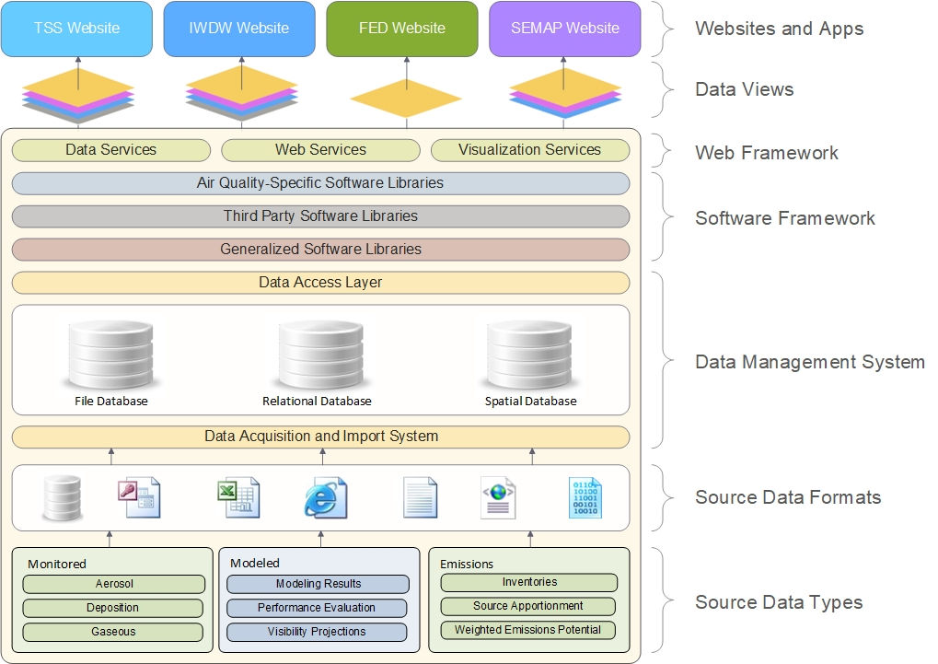
CIRA
Air Data Management System
Architecture
Notes:
Here’s another perspective from which to view the ADMS ecosystem, showing how individual applications like the Data Warehouse benefit from and leverage the integrated ADMS framework.

Slide 15
Interdependencies and Considerations
IMPROVE
Monitoring Tools
MPE
IMPROVE RHR
Model-to-Obs
CASTNET
NADP
Modeling Tools
Modeling Data
AQS
Emissions Tools
Emissions Data
All three systems share data
All three systems share hardware
All three systems share software
All three systems share databases
Non-WRAP states use these systems
Universities are 2nd only to states in usage
Next round of Regional Haze planning
Next round of modeling
Notes:
Some interdependencies and considerations to note when understanding the context within which the Data Warehouse exists…

Slide 16
Funding ecosystem
Why do I keep mentioning FED, TSS, and ADMS?
Because none of the ADMS projects (FED, TSS, IWDW) are fully funded by themselves. There’s only one full-time employee (FTE) to manage the operation, maintenance, and refinement of all three projects. And because there’s no such thing as “part of a person”, if there’s not sufficient funding across all three projects to fully fund at least 1 FTE, then all three projects will likely end.
1 FTE

Slide 17
Funding summary
Current funding summary:
BLM: $100K
EPA: $ 21K
USFS: $ 8K
NPS: $ 31K
Total: $160K
The ADMS systems (FED, IWDW, and TSS) are fully funded (1 FTE) through May 2024.
Notes:
Here’s a summary of the current ADMS funding situation. We’re currently operating with about $160K from a total of four agencies. What this means is that the ADMS systems (FED, Data Warehouse, and TSS) are essentially fully funded through May 2024.

Slide 18
Funding and Risk Calendar for ADMS (IWDW, TSS, FED)
Recommended window of action
Holidays
2023
2024
Potentially impactful decisions must begin…
No IWDW, FED, or TSS
The ADMS systems are fully funded (1 FTE) through May 2024
There will only be ~$55K left in June 2024
About $220K per year is required to fully fund (1 FTE) the ADMS systems
Notes:
So what does this mean from a planning and timing perspective? Here’s a sort of “funding and risk calendar” to illustrate where the rubber meets the road. As of today, we have 11 months before it all goes away, but only about six months before impactful decisions may have start being made, to put it realistically.

Slide 19
Intermountain West Data Warehouse
The End
Thanks!
https://views.cira.colostate.edu/iwdw

